Slide 1

BTC/USDT Market Predictive Model Presentation
SARIMA-based Predictive Models

Slide 2

INTRODUCTION
In the volatile world of cryptocurrency trading, having a reliable predictive model is crucial. These models aim to forecast BTC/USDT market trends to inform strategic decisions.

Slide 3
SARIMA

Slide 4
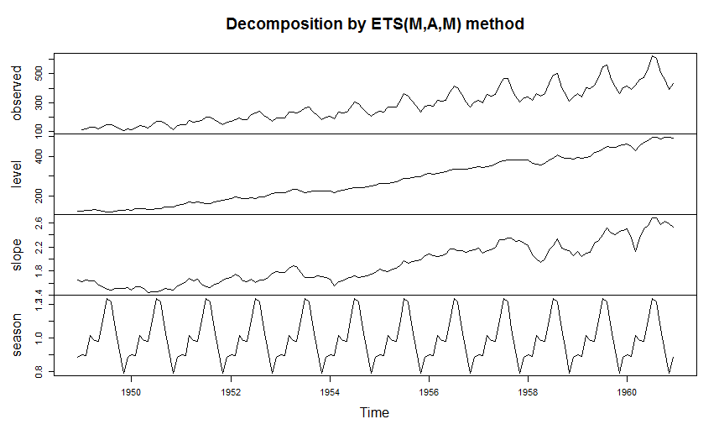
SARIMA - Seasonal AutoRegressive Integrated Moving Average
Key Parameters:
p, d, q: Non-seasonal parameters governing AR, differencing, and MA components.
P, D, Q, s: Seasonal parameters for seasonality and its characteristics.
Application:
Ideal for time series with noticeable seasonality, such as financial market data.
Advantages:
Robust handling of temporal dependencies and seasonality.
Applicable to dynamic and changing patterns in data.
This Photo by Unknown author is licensed under CC BY-SA.

Slide 5

Why SARIMA?
Handling Seasonality
Temporal Dependencies
Dynamic Nature of Cryptocurrency Markets:
Iterative Parameter Selection
Consideration for Non-Stationarity

Slide 6
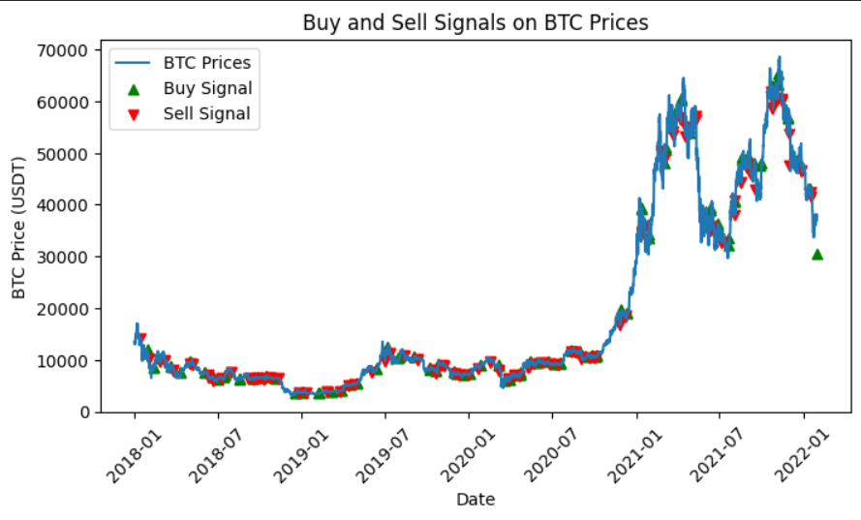
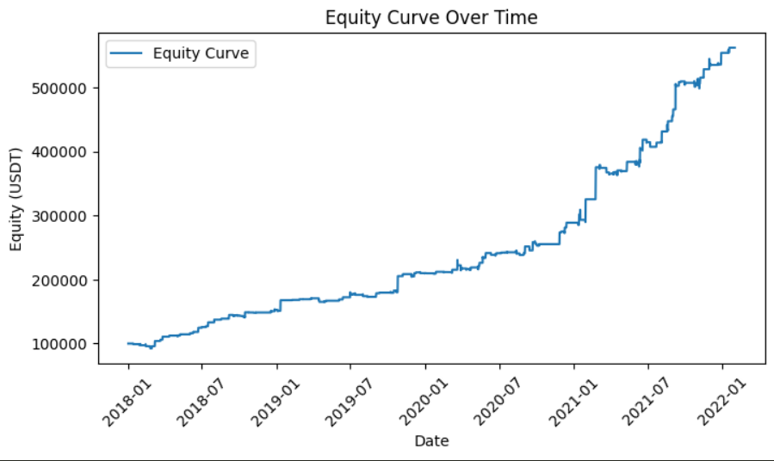
Backtesting Results
Trading Algorithm:
Buy shares when its 78-hour moving average goes above the 144-hour moving average.
Sell shares of the stock when its 78-hour moving average goes below the 144-hour moving average.
Equity Curve Analysis:
Observation: The SARIMA model generates signals based on the dynamics of the equity curve.
Characteristic: The equity curve demonstrates a rise, triggering sell signals during dips and buy signals during upward movements.
Buy/Sell Signals:
Strategic Indicators: Signals are strategically generated to capitalize on the observed patterns in the equity curve.
Pattern Recognition: Buy signals coincide with upward movements, while sell signals align with dip points
Performance Metrics:
Sharpe Ratio: 1.1299
Annualized Returns: 10.16%
Maximum Drawdown: 7.92%

Slide 7
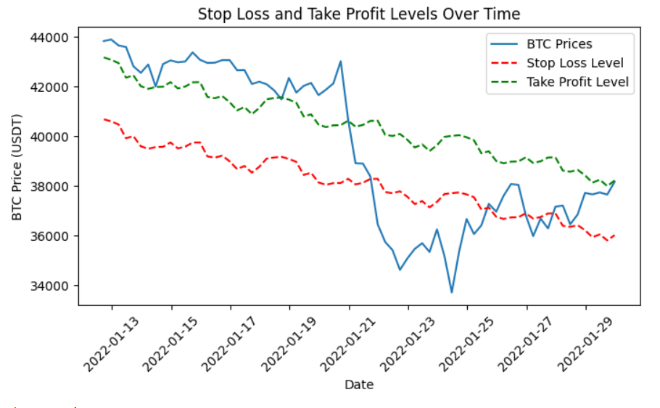
Risk Management Strategy
Stop-Loss and Take-Profit Levels:
Parameters: Stop-loss set at 2% below the current price.
Risk-Reward Ratio: Take-profit level set at a ratio of 2:1 compared to the stop-loss level.
Risk-Reward Balance:
Objective: Achieve a balance between protecting capital and maximizing returns.
Stop-Loss: Limits potential losses in the event of adverse market movements.
Take-Profit: Locks in profits at a favorable risk-reward ratio.
Adaptability to Market Conditions:
Dynamic Levels: The approach adjusts stop-loss and take-profit levels based on changing market dynamics.
Responsive Strategy: Adapts to both volatile and stable market periods.

